Slide 1
Conceptual approaches to teaching multivariable statistical thinking:
Using simulation methods and visualization
Beth Chance - Cal Poly San Luis Obispo
bchance@calpoly.edu

Slide 2
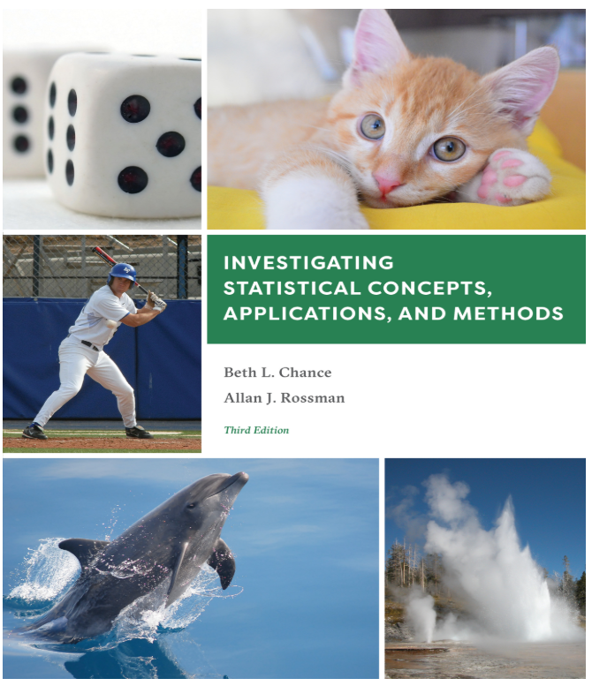
Joint work with
Nathan Tintle, Dordt University
Karen McGaughey, Cal Poly
Soma Roy, Cal Poly
Todd Swanson, Hope College
Jill VanderStoep, Hope College
Allan Rossman, Cal Poly

Slide 3


Motivation
GAISE Guidelines (2016)
  1. Teach statistical thinking.
    Teach statistics as an investigative process of problem-solving and decision making.
    Give students experience with multivariable thinking.
Introduction to Statistical Investigations
(Wiley, 2nd edition)
  Centers on simulation-based inference, variability, strength of evidence, 6-step statistical investigative process
Notes:
Reflects that the knowledge necessary to understand most research articles has been shifting

Slide 4
Overview
How simulation-based inference can extend to intermediate topics
  Randomized block design
  Interactions
How can we help students better visualize/understand confounding variables and conditional/adjusted associations
Algebra-based second course, First course, Modified/Accelerated first course
Notes:
More and more students coming out of AP Statistics (common core), where to next?
Still conceptual and visual
Also curious about what “pillars” are needed first in order to build on this thinking

Slide 5
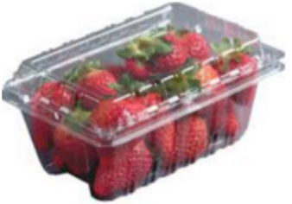
Example 1: Strawberry storage
Study background:
  Investigate the effects of storage method on the firmness of strawberries.
    Normal air for 2-days at 0.5ºC, 2-days at room temp
    Modified air for 2-days at 0.5ºC, 2-days at room temp
    Control
  5 clamshells assigned to each storage method
  Average firmness (Newtons) measured for each clamshell
Smith & Skog, 1992
Notes:
file:///C:/Users/bchance/Dropbox/My%20Documents/applets-Desktop/applets%20new/javascript/RCBD/rcbd47.htm

Slide 6
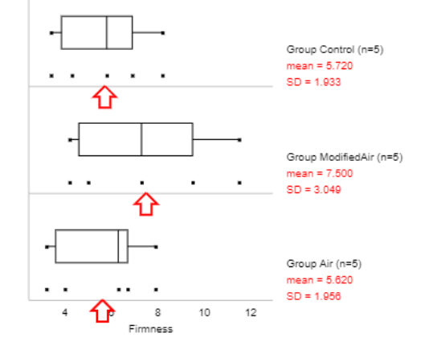
Example 1: Strawberry storage
Study results

Slide 7
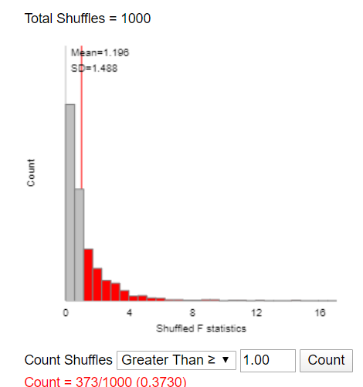
Example 1: Strawberry storage
Simulation-based Inference
3S process
  Statistic: Comparing the 3 treatment means
    F-statistic = 1.00
  Simulation: Randomly reassign the firmness values among the treatment groups (shuffling the response variable)
    Randomization distribution
  Strength of evidence: How often do we get an F-statistic > 1.00 in this “null” distribution?

Slide 8
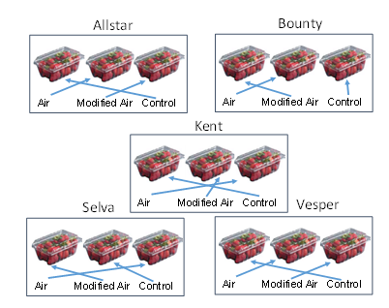
Example 1: Strawberry storage
But the researchers took into account one possible source of variation – strawberry variety

Slide 9
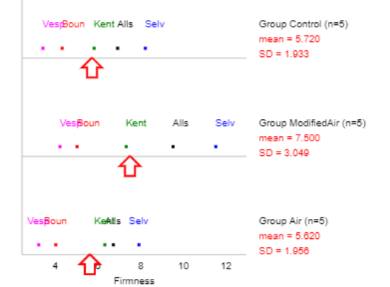
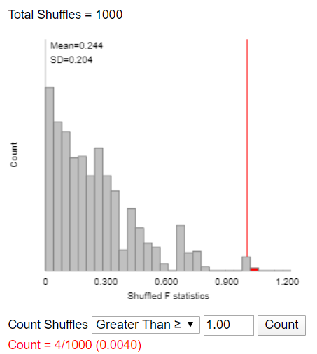
Example 1: Strawberry storage
Randomized Block Design
One approach: Change the simulation to match the study design
  Randomly shuffle within each strawberry variety

Slide 10
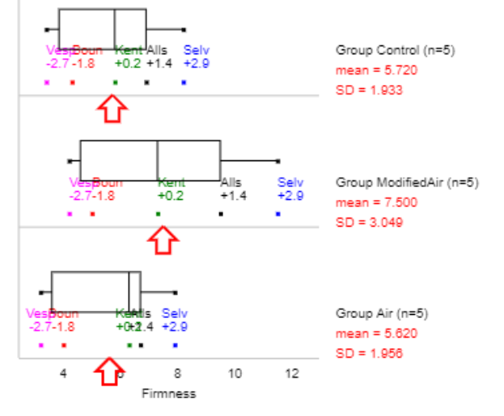
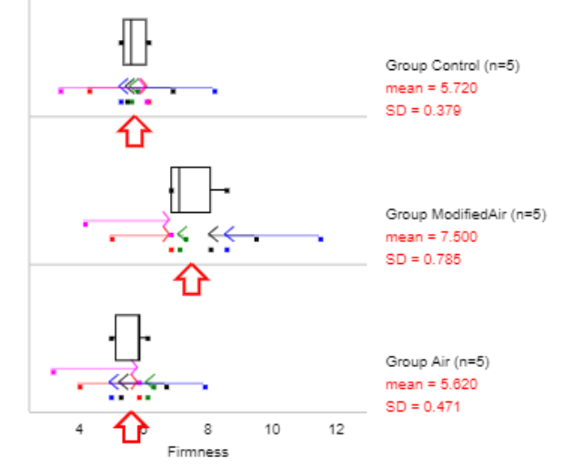
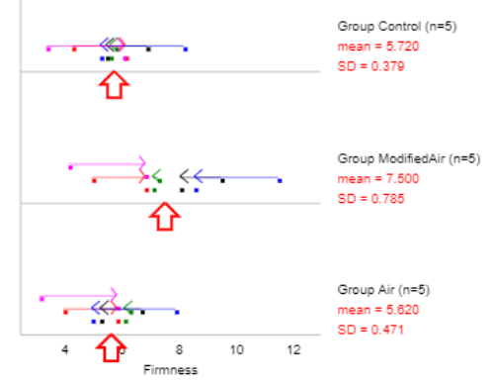

Example 1: Strawberry storage
Randomized Block Design
Another approach: Change the statistic
  Subtract off the block effects

Slide 11
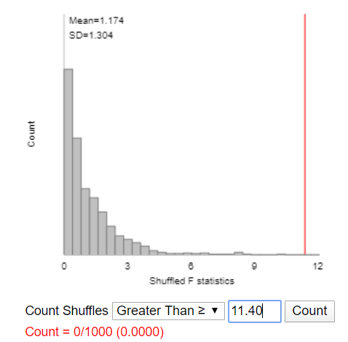
Example 1: Strawberry storage
Randomized Block Design

Slide 12
Example 1: Strawberry storage
Key ideas
  Principle and benefits of randomized block design
  Analysis must match design
  Can “adjust out” block effects
  Strength of evidence depends on study design and choice of statistic
  Simulation vs. “Theory-based” approach

Slide 13

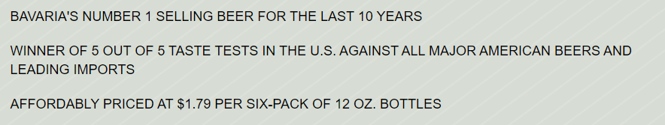
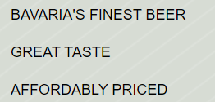
Example 2: Best ad?
Rossiter & Percy (1978)
  Concrete ad copy
  Abstract ad copy
Notes:
file:///C:/Users/bchance/Dropbox/My%20Documents/applets-Desktop/applets%20new/javascript/RCBD/twoway4.html

Slide 14
Example 2: Best ad?
Rossiter & Percy (1978)
  Visual: “a large picture of the product with small verbal copy underneath”
  Verbal: “large verbal copy with a small picture of the project underneath”
  A “no picture” control condition was rejected as being atypical of beer advertisements

Slide 15
Example 2: Best ad?
Does the Type of imagery modify the effect of Type of claim on consumers’ rating of the product?
(n = 88)
 |  | Mean rating
 |  | Type of imagery
 |  | Verbal | Visual | overall
Type of claim | Abstract | 2.64 | 2.91 | 2.77
 | Concrete | 2.96 | 5.55 | 4.25
 | overall | 2.80 | 4.23

Slide 16
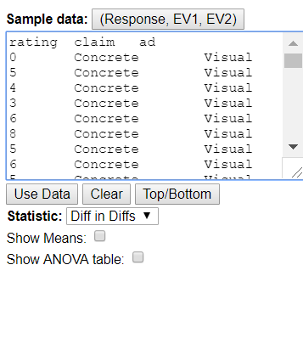
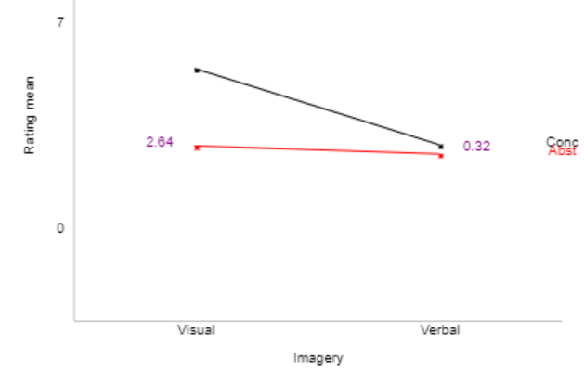

Example 2: Best ad?

Slide 17
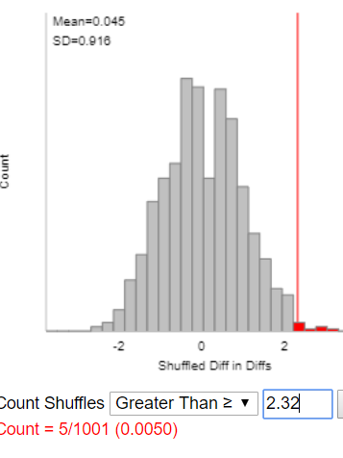
Example 2: Best ad?
Key ideas
  Shuffling the response maintains the same x-variable structure
  Can focus on a more intuitive statistic and get to the “punchline” sooner

Slide 18
Example 3: Confounding variables
Statistical Sleuth report on data from the 1998 U.S. Current Population Survey for weekly wages and whether or not they were black.
A simplified version of the data might look like …

Slide 19
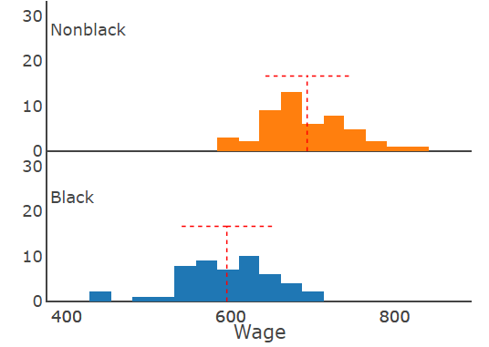
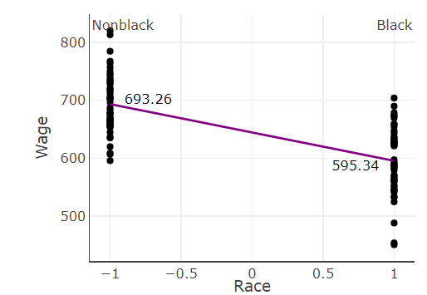

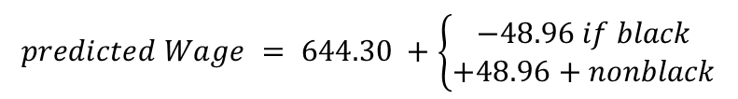
Example 3: Confounding variables
$$predicted Wage = 644.30 +\left\{\begin{matrix}−48.96 if black \\ +48.96+nonblack\end{matrix}\right.$$
t =-9.03
Notes:
file:///C:/Users/bchance/Dropbox/My%20Documents/applets-Desktop/applets%20new/javascript/multreg/multreg/multreg23.html

Slide 20
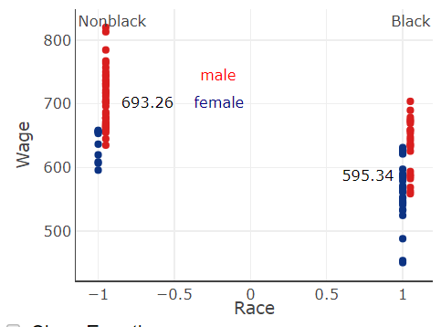
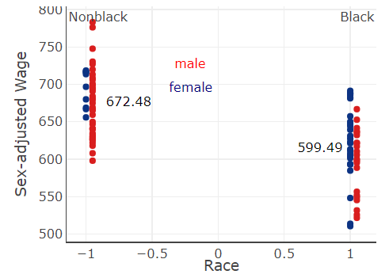
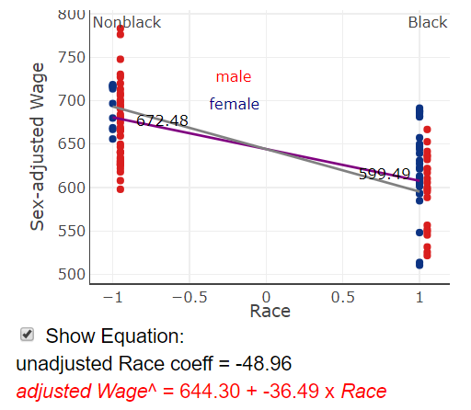
Example 3: Confounding variables
Wage = Overall + Race effect + Sex effect
Wage – Sex Effect = Overall + Race effect

Slide 21
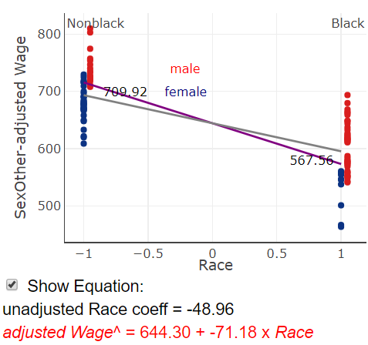
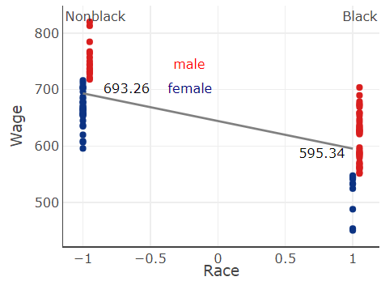
Example 3: Confounding variables
What if

Slide 22
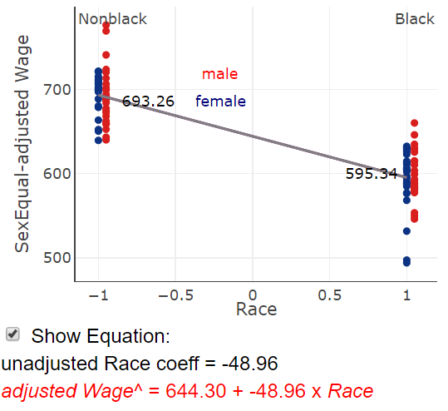
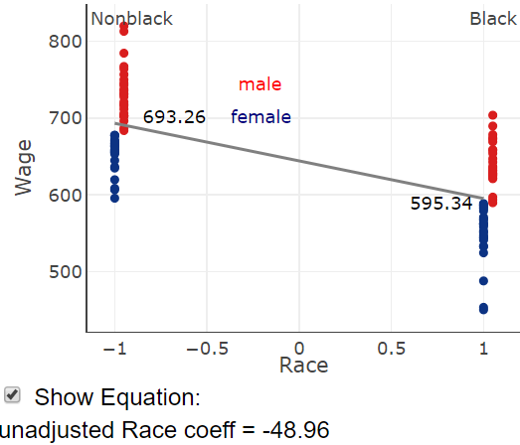
Example 3: Confounding variables
What if

Slide 23
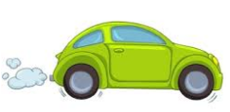
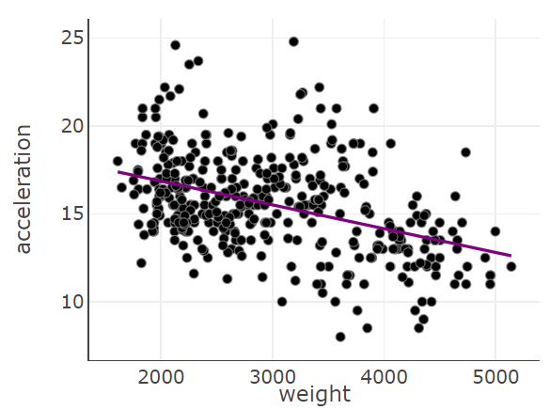
Example 4: Multiple variables
Quinlan (1993)
Auto mpg dataset
  https://archive.ics.uci.edu/ml/datasets/Auto+MPG
  Acceleration = time to increase from 0 to 60 mph
  Divide weight by 1000
Heavier cars are able to accelerate
from 0 mph to 60 mph in a shorter
amount of time?

Slide 24
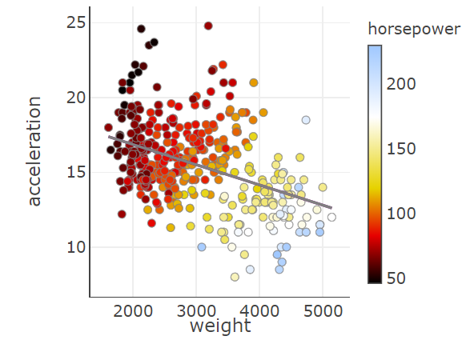
Example 4: Multiple variables
Visualizations

Slide 25
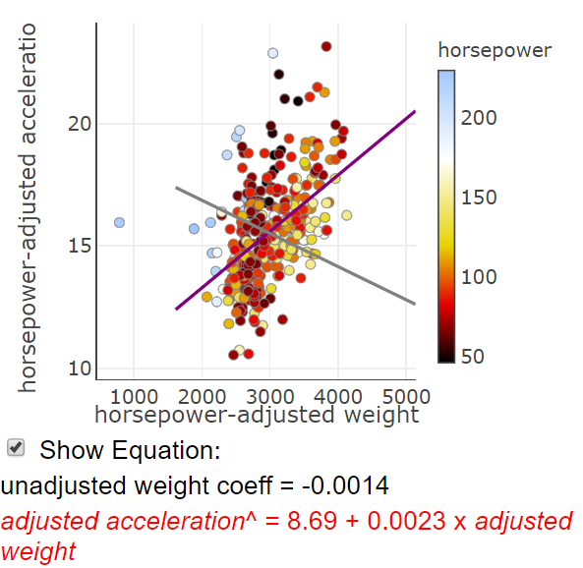
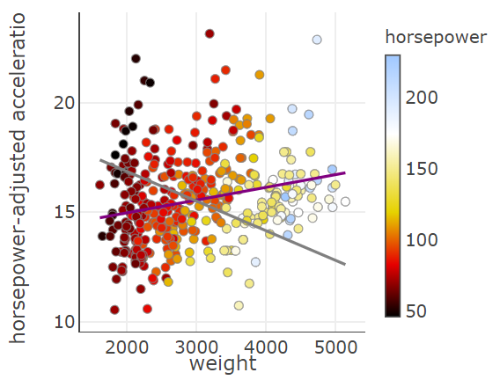
Example 4: Multiple variables
Visualizations

Slide 26
Example 4: Multiple variables
Key ideas
  Helps student to visualize the adjusted association
  Quick/easy way to produce added variable plots
  Simulation-based inference: Can see impact of variation inflation from correlated variables

Slide 27
Assessment
Study on the impacts of alcohol consumption on inflammation in the body, as measured by the level of
C-reactive protein (CRP) in the blood.
Three-thousand twenty six (3,026) adults between the ages of 45 and 60 were followed for one year.
Type of Drinker | n | Mean CRP (mg/dL) | SD CRP (mg/dL)
Non-drinker | 500 | 3.0 | 1.5
Light | 1120 | 4.5 | 1.6
Moderate | 910 | 7.0 | 2.1
Heavy | 496 | 10.0 | 2.8

Slide 28
Assessment
CRP is related to lots of unhealthy behaviors
Also examined total time spent exercising with heart rate above 100 bpm (in minutes).
Weekly Exercise | n | Mean CRP (mg/dL) | SD CRP (mg/dL)
Moderate/High | 1576 | 5.8 | 2.2
None/Low | 1450 | 7.1 | 2.5

Slide 29
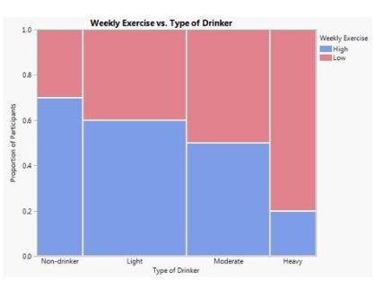
Assessment
And exercise appears to be associated with decreasing use of alcohol

Slide 30
Assessment
Weekly Exercise | n | Mean CRP (mg/dL) | SD CRP (mg/dL)
Mod/High | 1576 | 5.8 | 2.2
None/Low | 1450 | 7.1 | 2.5
Type of Drinker | n | Mean CRP (mg/dL) | SD CRP (mg/dL)
Non-drinker | 500 | 3.0 | 1.5
Light | 1120 | 4.5 | 1.6
Moderate | 910 | 7.0 | 2.1
Heavy | 496 | 10.0 | 2.8
If we adjust the mean CRP in each drinking group for level of exercise, what is most likely to happen?

Slide 31
Next steps
GAISE: “Give students experience with multivariable thinking”
More assessment items related to multivariable thinking
  Reducing unexplained variation
    Design (randomized block design, inclusion criterion)
    Adding variables to the model
      How much relates to the association among the variables
      How form of adjusted association relates to association among the variables
    Interaction
Multi-institutional assessment project (pre/post)
  Email me or Nathan ntintle@dordt.edu for more information

Slide 32
Questions?
References/Acknowledgements:
  Intermediate Statistical Investigations
    Now available from Wiley
  www.isi-stats.com (including applets)
  This work partially supported by NSF DUE #16-12201
See also
  CMU Integrated Statistics Learning Environment (ISLE):
  http://www.stat.cmu.edu/isle
  iNZight for data analysis: https://www.stat.auckland.ac.nz/~wild/iNZight/

Slide 33
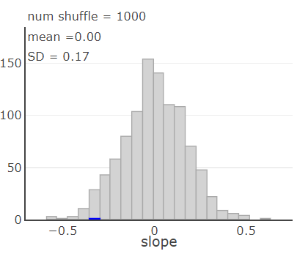
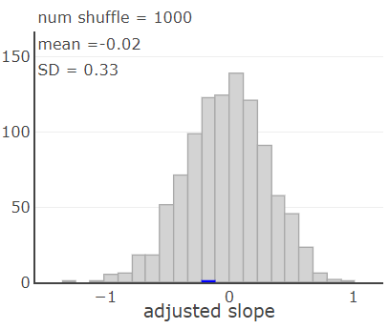
Example 4: Multiple variables
Simulation
Unadjusted slopes
Adjusted slopes

